Slide 1
Trivial Pursuit : The World of Computing
Groupe n°A06
LADERRIERE Loïc & EL KOUKOUCHI Bilal
& SAHIOUNI Sacha

Slide 2
Summary
Introduction
Scrum methodology
Our Working method
Demonstration of the application
Diagrams
Conclusion

Slide 3
Introduction
The subject
  Java Application of « Trivial Pursuit » game
  In english
Specific Instructions
  Not the same gameboard
  We use a wheel
  Network game mode

Slide 4
Scrum methodology
Work divided into severals sprints
Report for each sprint
Speak with the product owner
Adaptation

Slide 5
Our working method
We use GIT to modify the code
We use a voice over internet protocol (VoIP) → Discord
Pair-programming → Teamviewer
Days organization

Slide 6
Demonstration

Slide 7
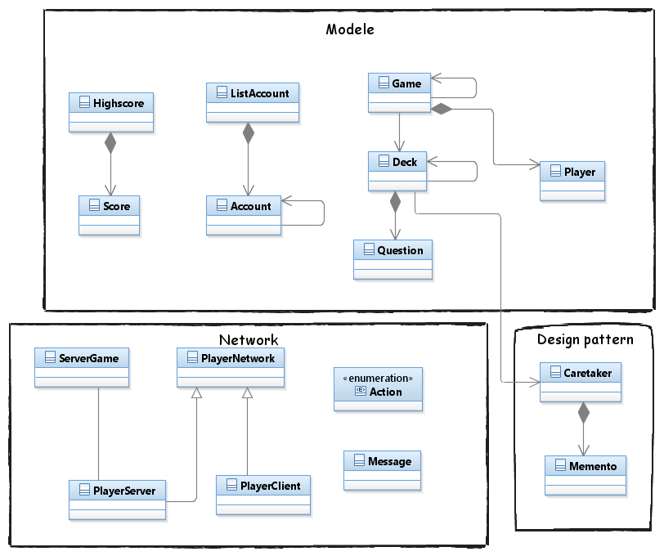
General diagram

Slide 8
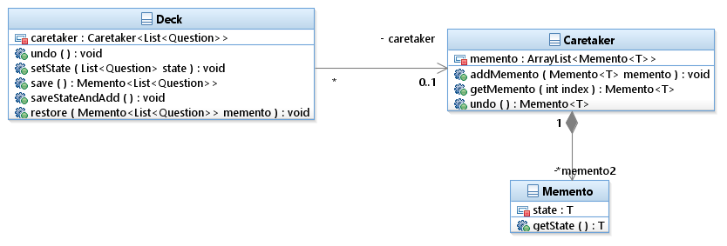
Design pattern diagram

Slide 9
Conclusion
Good exercise to increase our knowledge
Best organization team working method
Exceed our expectations

